Slide 1


What‘s an API?
Vishesh Oberoi
Technical Evangelist, Microsoft
@ovishesh

Slide 2
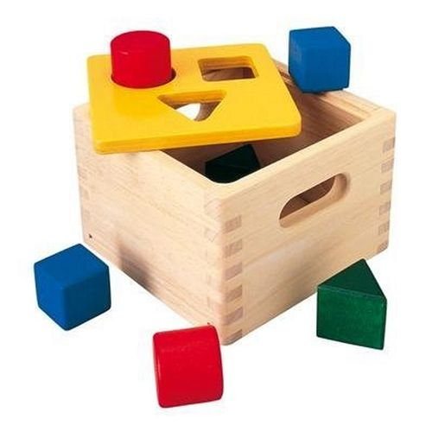
Notes:
This API takes circles, triangles, and squares and lets them into the box. It forces the user or client program to organize the inputs going into the box to the designer's liking, presumably so they're easier to work with.

Slide 3
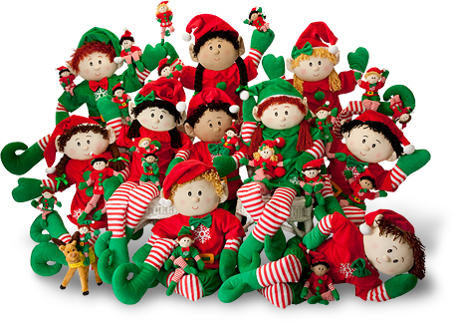
Notes:
If magic elves lived in the box, we could also have this API serve data out by having the elves push the shapes back out of the holes. This would be useful to the user/client program because now the outputs would come out in the way users expect them to. We would expect squares to come out of the square hole and not circles, and this example API would always do that.

Slide 4
def api():
return {
“acronym”: “Application Programming Interface”,
“definition”: “a set of routines, protocols and tools for building software applications.”,
“function”: “digital middleman”

Slide 5
Application Programming Interface

Slide 6
Application Programming Interface
“Apps”

Slide 7
Application Programming Interface
“how all the software is created that make our lives so much easier.”

Slide 8
Application Programming Interface
“common boundary shared by two applications”

Slide 9
Application Programming Interface
“tldr;”:
“a way for programmers to communicate”
Notes:
It describes what functionality is available, how it must be used and what formats it will accept as input or return as output.
In recent years, the term API colloquially is used to describe both the specification and service itself

Slide 10
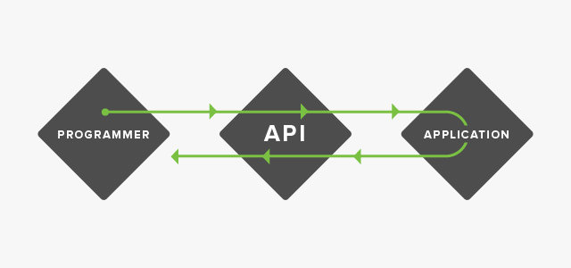
Notes:
To help visualize this concept, imagine an API as the middleman between a programmer and an application.
This middleman accepts requests and, if that request is allowed, returns the data.
The middleman also informs programmers about everything they can request, exactly how to ask for it and how to receive it.

Slide 11
The cloud disruption is in full motion
“Infinite” on-demand storage and compute
Instant access to high-level PaaS services
Disruption brings new opportunities and requirements
Big data/compute enables insight quantum leaps
On-demand scale demands automation
On-prem infra, data, and apps require hybrid-cloud

Slide 12
When APIs Go Bad

Slide 13
When APIs Go Bad
Applications Affected
Monetary Loss
Business Loss
Shut Down

Slide 14
Enterprise World

Slide 15
Enterprise Systems
Traditionally have 6-7 different software and systems
3 layers:
Front layer – UI, UX
Middle layer – Stitch up all the different components
Backend layer – Web Services, etc.

Slide 16
Enterprise Systems
Their Massive
Their Vast
But, their a Platform! :D
Notes:
A platform is a group of technologies that are used as a base upon which other applications, processes or technologies are developed.

Slide 17
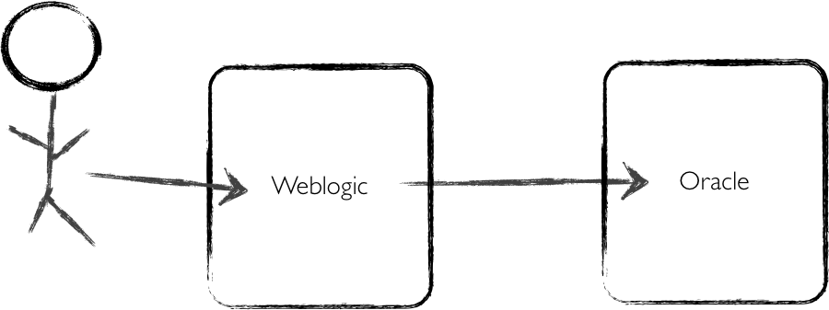
Legacy Approach
Notes:
The typical legacy ES was monolithic and fairly static, with a sing
Ten years ago, this was what production ES looked like - i.e. application tier talking to a single database that was updated every six months.

Slide 18
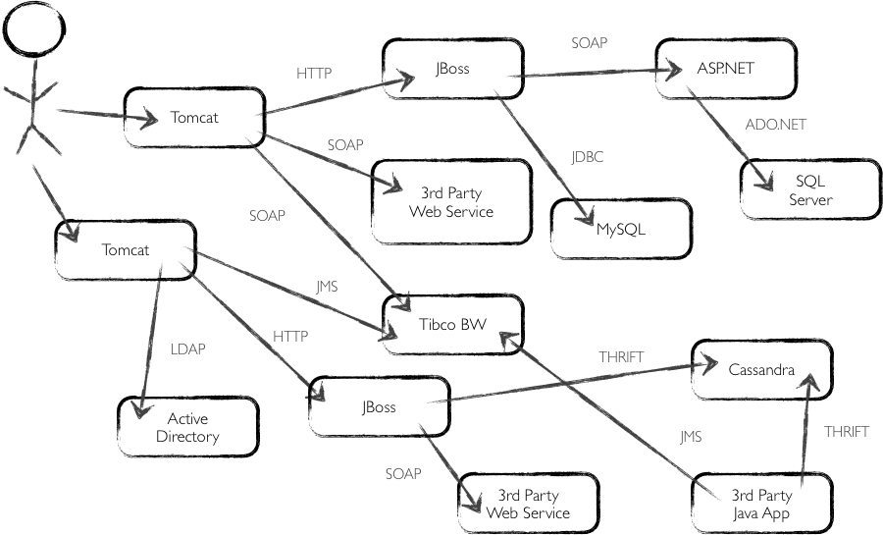
Modern Approach
Notes:
Today, enterprise web applications are much more complex than they were ten years ago.
The new normal for these applications includes multiple application tiers communicating via a service-oriented architecture (SOA) that interacts with several databases and third-party web services while processing items out of caches and queues.

Slide 19
Message
Bus
CRM
Flat
Files
EAI
Custom
Systems
Backend
Database
EAI
EAI
ERP
Web
Service
EAI
EAI
EAI
EAI
EDI
SSIS
Adapters
1
2
Replication
1
2
SQL Server
Subscriber
(Read)
SQL Server
Subscriber
(Read)
Replication
SQL Server
Subscriber
(Read)
SQL Server
Subscriber
(Read)
1
2
NLB Cluster
SQL Server
Publisher
(Write)
NLB Cluster
1
2
SQL Server
Subscriber
(Read)
SQL Server
Subscriber
(Read)
SQL Server
Subscriber
(Read)
Server Facade
Replication
Replication
SQL Server
Subscriber
(Read)
Virtual
IP
Virtual
IP
NLB Cluster
NLB Cluster
Virtual
IP
Virtual
IP
Cache
Cache
Cache
Cache
API
Server
API
Server
API
Server
NLB Cluster
API
Server
API
Server
API
Server
API Tier
API
Server
Virtual
IP
API
Server
Back Firewall
NLB Cluster
DMZ
Mobile Access Gateway
Virtual
IP
Mobile Access Gateway
Front Firewall
Internet
Notes:
The modern application has multiple clients from browser-based desktops to native applications on mobile.
As a result, it can be difficult to connect to all of these massive systems, applications, softwares, etc.
Explain the diagram.

Slide 20
Mobilising the Enterprise Systems

Slide 21
Enterprise Mobility
The best way to be Mobile-First is to be API-First
Integrate Integrate and orchestrate diverse proprietary APIs across myriad backend systems
Create mobile-friendly APIs to expose those backend systems to mobile devices
Create apps for devices that can interact with API data and keep working in an offline state
Notes:
A platform is a group of technologies that are used as a base upon which other applications, processes or technologies are developed.

Slide 22
Message
Bus
CRM
Flat
Files
EAI
Custom
Systems
Backend
Database
EAI
EAI
ERP
Web
Service
EAI
EAI
EAI
EAI
EDI
SSIS
Adapters
1
2
Replication
1
2
SQL Server
Subscriber
(Read)
SQL Server
Subscriber
(Read)
Replication
SQL Server
Subscriber
(Read)
SQL Server
Subscriber
(Read)
1
2
NLB Cluster
SQL Server
Publisher
(Write)
NLB Cluster
1
2
SQL Server
Subscriber
(Read)
SQL Server
Subscriber
(Read)
SQL Server
Subscriber
(Read)
Server Facade
Replication
Replication
SQL Server
Subscriber
(Read)
Virtual
IP
Virtual
IP
NLB Cluster
NLB Cluster
Virtual
IP
Virtual
IP
Cache
Cache
Cache
Cache
API
Server
API
Server
API
Server
NLB Cluster
API
Server
API
Server
API
Server
API Tier
API
Server
Virtual
IP
API
Server
Back Firewall
NLB Cluster
DMZ
Mobile Access Gateway
Virtual
IP
Mobile Access Gateway
Front Firewall
NoSQL
Internet
NoSQL
NoSQL
NoSQL
NoSQL
NoSQL
Notes:
Enterprise Mobility

Slide 23
Web Services
Notes:
Today, companies rely on thousands of different software applications, each with their own role to play in running a business.
These different software applications run on a wide range of different platforms and operating systems, and they are implemented in different programming languages.
As a result, it is very difficult for different applications to communicate with one another and share their resources in a coordinated way.

Slide 24
Message
Bus
CRM
Flat
Files
Custom
Systems
Backend
Database
ERP
Web
Service
EDI
Server Facade
How do you get from here
To here?
API Tier
DMZ
Devices

Slide 25
Web Services
“a software system designed to support interoperable machine-to-machine interaction over a network.”
Source: W3C
Notes:
A platform is a group of technologies that are used as a base upon which other applications, processes or technologies are developed.
A Web service is a method of communication between two electronic devices over a network. It is a software function provided at a network address over the Web with the service always on as in the concept ofutility computing.

Slide 26
Web Services
Web services communicate using open protocols.
Web services are used by other applications.
Notes:
A platform is a group of technologies that are used as a base upon which other applications, processes or technologies are developed.
A Web service is a method of communication between two electronic devices over a network. It is a software function provided at a network address over the Web with the service always on as in the concept of utility computing.

Slide 27
Web Services
REST-compliant Web Services
Arbitrary Web Services
Notes:
We can identify two major classes of Web services:
REST-compliant Web services, in which the primary purpose of the service is to manipulate representations of Web resources using a uniform set of stateless operations.
Arbitrary Web services, in which the service may expose an arbitrary set of operations.
Lets focus on REST-complaint ones.. [next slide]

Slide 28

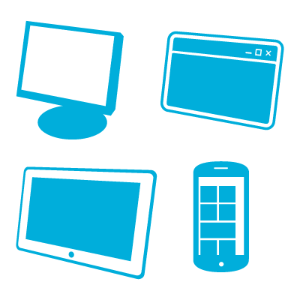
REST Services – How?
HTTP
Server
Client(s)
Notes:
Make a call from a Client to a Server
you get data back from Server
over the HTTP Protocol
What is REST?
Representational State Transfer

Slide 29
JSON
Notes:
Today, companies rely on thousands of different software applications, each with their own role to play in running a business.
These different software applications run on a wide range of different platforms and operating systems, and they are implemented in different programming languages.
As a result, it is very difficult for different applications to communicate with one another and share their resources in a coordinated way.

Slide 30
JSON
JavaScript Object Notation
Light-weight
Language independent - most programming languages can easily read it and instantiate objects
For more information - http://json.org/
Its cool, its efficient and great to work with
Notes:
Various ways of representing Web Services – JSON is one of the lightest and my personal FAV! :D
JSON is simpler than XML and more compact
No closing tags, but if you compress XML and JSON the difference is not so great
XML parsing is hard because of its complexity
JSON has a better fit for OO systems than XML
JSON is not as extensible as XML
Preferred for simple data exchange by many
Less syntax, no semantics
Schemas? We don’t need no stinkin schemas!
Transforms? Write your own.

Slide 31
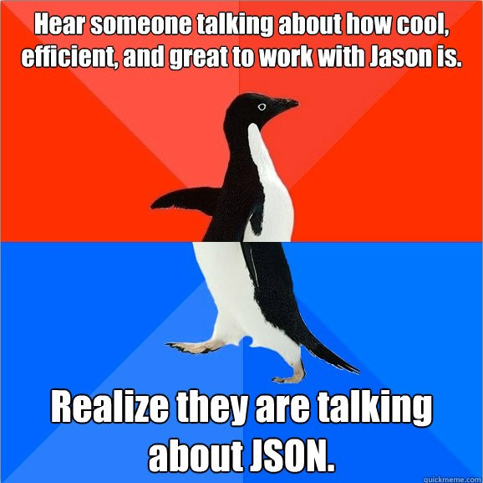
JSON
Notes:
Various ways of representing Web Services – JSON is one of the lightest and my personal FAV! :D
JSON is simpler than XML and more compact
No closing tags, but if you compress XML and JSON the difference is not so great
XML parsing is hard because of its complexity
JSON has a better fit for OO systems than XML
JSON is not as extensible as XML
Preferred for simple data exchange by many
Less syntax, no semantics
Schemas? We don’t need no stinkin schemas!
Transforms? Write your own.

Slide 32
JSON
{
"firstName": "John",
"lastName" : "Smith",
"age" : 25,
"address" :
{"streetAdr” : "21 2nd Street",
"city" : "New York",
"state" : "NY",
”zip" : "10021"},
"phoneNumber":
[{"type" : "home",
"number": "212 555-1234"},
{"type" : "fax",
"number” : "646 555-4567"}]
}
This is a JSON object with five key-value pairs
Objects are wrapped by curly braces
There are no object IDs
Keys are strings
Values are numbers, strings, objects or arrays
Arrays are wrapped by square brackets
Notes:
Various ways of representing Web Services – JSON is one of the lightest and my personal FAV! :D

Slide 33
JSON
Try it yourself:
https://api.github.com/users/<GIT-USERNAME>/repos
For Example:
https://api.github.com/users/ovishesh/repos
We will come back to this!

Slide 34
RESTful APIs
Notes:
What is an API?
Application Programming Interface
What is REST?
Representational State Transfer
Make a call from a client to a Server and you get data back over the HTTP Protocol

Slide 35
RESTful API - HTTP methods
Resource | GET | PUT | POST | DELETE
Collection URI, such ashttp://example.com/resources | List the URIs and perhaps other details of the collection's members. | Replace the entire collection with another collection. | Create a new entry in the collection. The new entry's URI is assigned automatically and is usually returned by the operation. | Delete the entire collection.
Element URI, such ashttp://example.com/resources/item17 | Retrieve a representation of the addressed member of the collection, expressed in an appropriate Internet media type. | Replace the addressed member of the collection, or if it doesn't exist, create it. | Not generally used. Treat the addressed member as a collection in its own right and create a new entry in it. | Delete the addressed member of the collection.
Source: http://en.wikipedia.org/wiki/RESTful_API_Modeling_Language#Applied_to_web_services

Slide 36
RESTful APIs - Examples
Lets make a live REST API request using Facebook’s GraphAPI.
http://www.facebook.com/azure
http://graph.facebook.com/azure
Notes:
What we doing is making a graph API request from our browser
What we get back is JSON

Slide 37
RESTful APIs - Examples
Now lets see what are parameters.
http://graph.facebook.com/azure?fields=id,name,likes

Slide 38
RESTful APIs - Examples
Defines the interface between client and server
Simple architecture (thanks to HTTP Verbs)
Resource based (as opposed to Action based)
Typically JSON or XML format representation
HTTP Verbs + URIs (resource name) + HTTP response (status, body)
Stateless – Server contains no Client state; Client holds the state
Notes:
Resource based (as opposed to Action or methods based in SOAP for eg.
- Nouns vs Verbs
- GET Person vs GET PersonData

Slide 39
Questions?

